Slide 1
Canvas Animations
Telerik Software Academy
Learning & Development Team
http://academy.telerik.com

Slide 2
Homework
Finish the aircraft game from the demo
Create flying monsters that can kill the fighter
The fighter can kill the monsters
When the fighter is destroyed, a high score is calculated based on the time he was alive and the number of monsters killed
Create the famous game Falling Rocks (Padashti kamani)
The game consists of a dwarf at the bottom of the field
The dwarf can move left and right
Rocks are randomly generated at the top of the field
The rocks can kill the dwarf
The dwarf must evade the rocks as long as possible

Slide 3
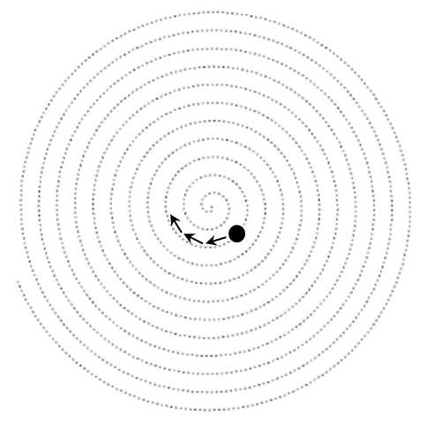
Homework (2)
Create a ball that is moving in a spiral trajectory, starting from the middle of the drawing field
*Hint: find the mathematical formula for the Archimedean spiral to calculate the trajectory of the ball

